Slide 1

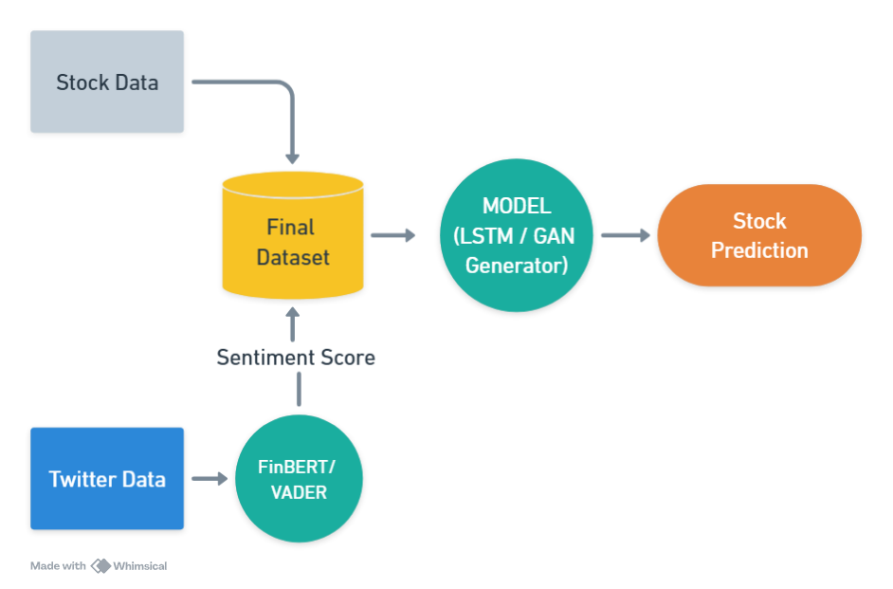
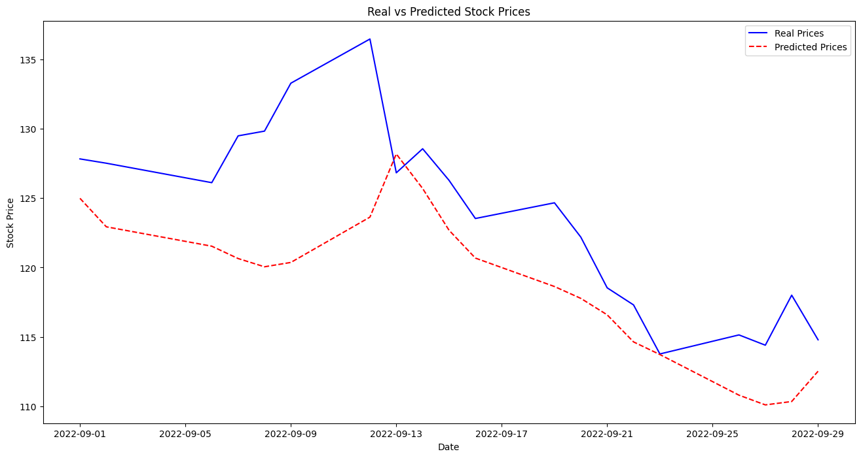
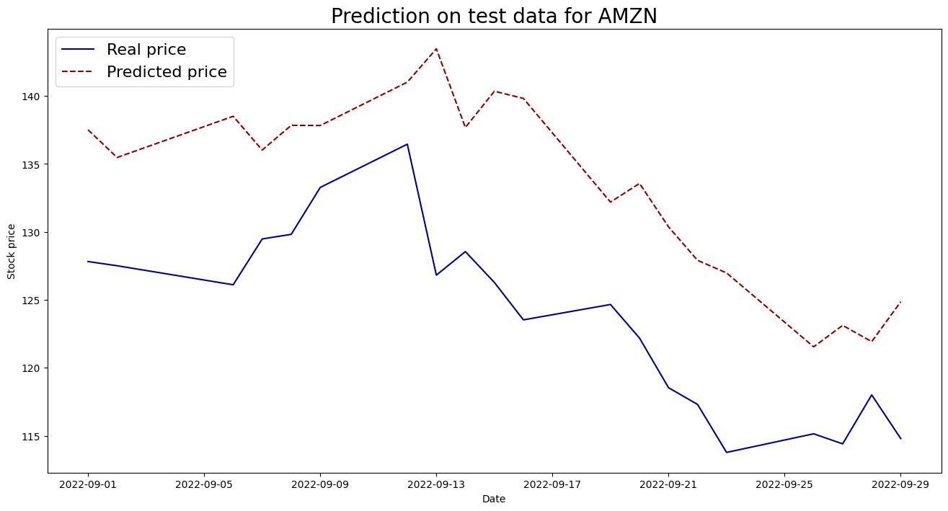
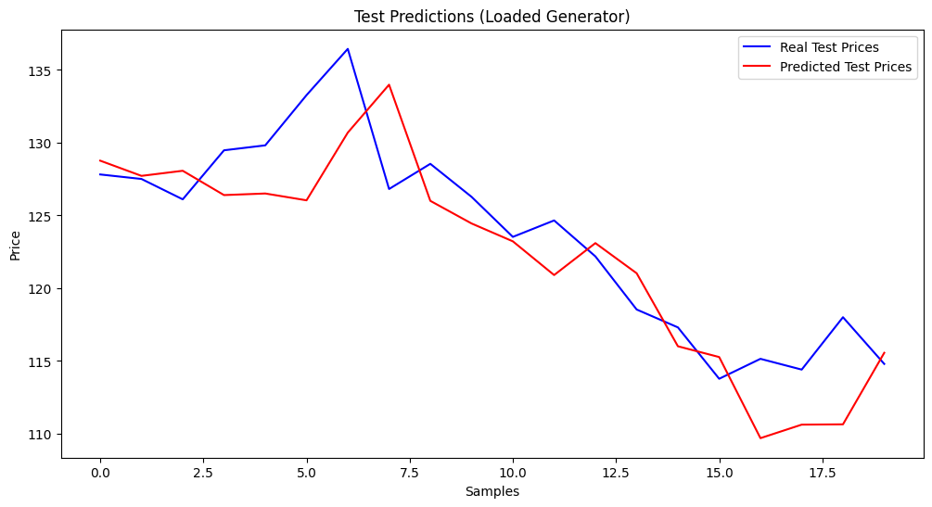
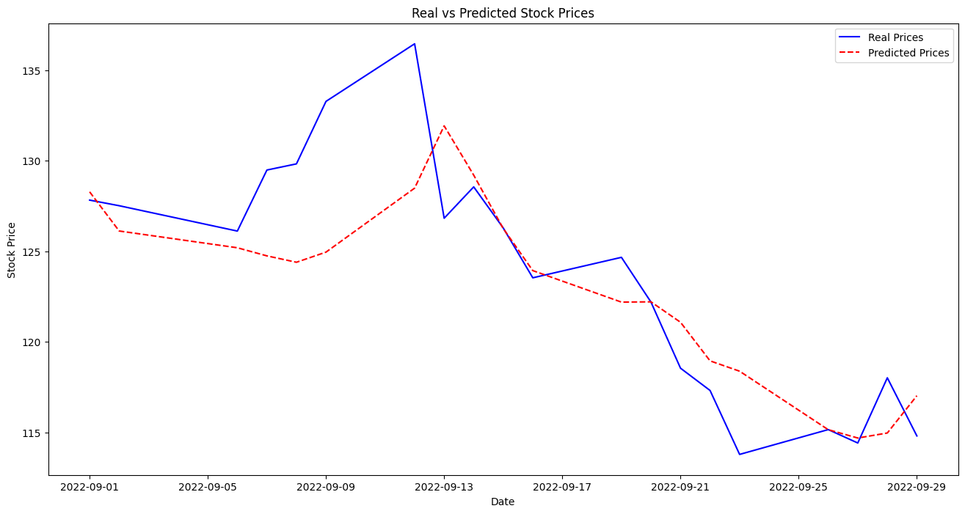
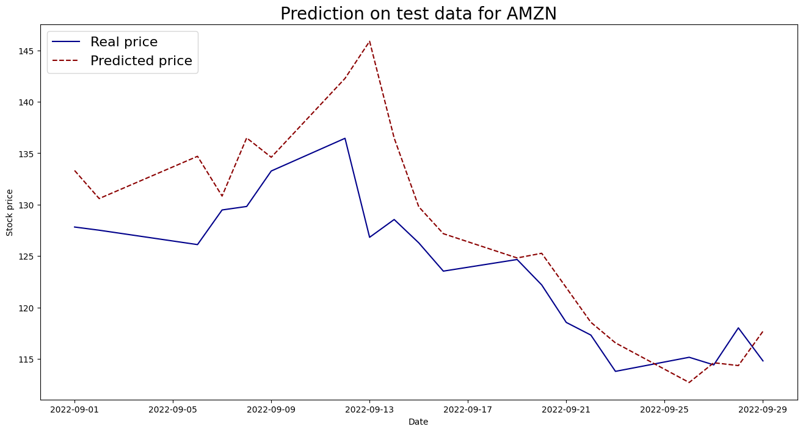
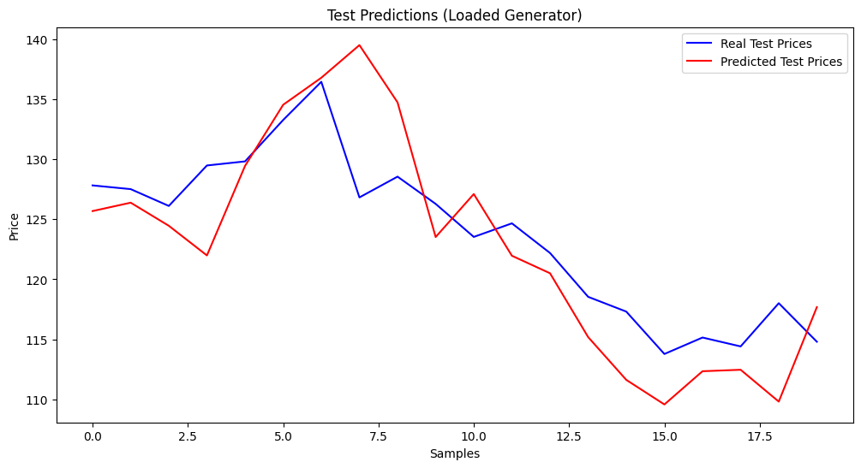
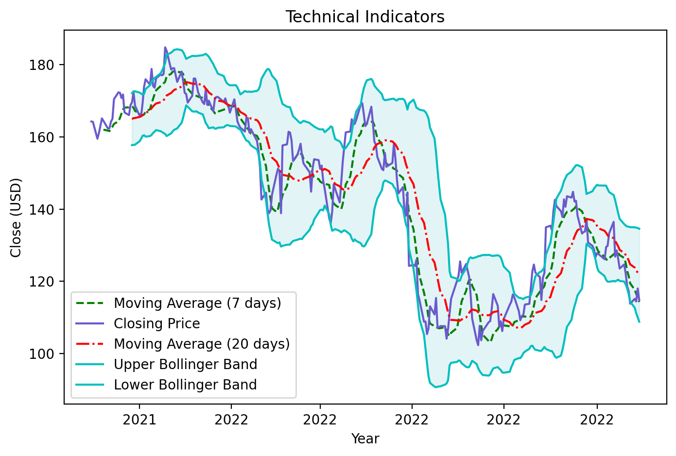
Stock Price Prediction Using Generative Adversarial Networks and Sentiment Analysis ( FinBERT and VADER )
Omkar Chavan, Roll No. 210280
Indian Institute of Technology, Kanpur
Abstract
Methodology
Discussion
Stock price prediction is challenging due to market volatility. This study integrates VADER and FinBERT sentiment analysis with models like LSTM, GAN, and WGAN-GP to improve forecasting. Using Amazon stock data and Twitter sentiment, FinBERT consistently outperformed VADER, with LSTM-FinBERT achieving the highest accuracy. The findings highlight the potential of combining deep learning with contextual sentiment analysis for reliable predictions.
The methodology integrates sentiment analysis with predictive models for stock price forecasting:
1. Sentiment Analysis:
VADER: Provides quick sentiment scores for social media data.
FinBERT: Delivers nuanced sentiment analysis for financial contexts.
2. Model Development:
  LSTM: Used as a baseline to capture temporal patterns.
  GAN: Generates synthetic price data to model nonlinear relationships.
  WGAN-GP: Improves training stability and enhances robustness.
Evaluation was conducted using metrics such as MSE, MAPE, and RMSE to
compare model performance.
Sentiment Analysis: FinBERT consistently outperformed VADER, reducing prediction errors due to its nuanced understanding of financial text.
Model Insights:
LSTM captured temporal dependencies effectively.
GAN modeled complex, nonlinear relationships but showed instability in training.
WGAN-GP improved stability and robustness, offering balanced performance.
Key Finding: Combining sentiment analysis with advanced models enhances accuracy in stock price forecasting.
Introduction
Table 1. Label in 24pt Calibri.
Significance of Stock Prediction:
Crucial for financial decision-making and anticipating trends in volatile markets.
Challenges in Prediction:
Traditional models like LSTM capture temporal patterns but often overlook market sentiment, a key driver of price movements.
Market Sentiment’s Role:
Reflects collective investor opinions, derived from news and social media.
Sentiment Analysis Tools:
VADER: Quick and interpretable for informal text.
FinBERT: Provides domain-specific, nuanced sentiment analysis for financial data.
Objective:
Enhance stock price prediction by integrating sentiment analysis with LSTM, GAN, and WGAN-GP models.
Results
Conclusions
VADER
VADER
VADER
FinBERT outperformed VADER across all models, proving its effectiveness for financial sentiment analysis.
LSTM with FinBERT achieved the best predictive accuracy, minimizing error metrics significantly.
WGAN-GP provided stability and robustness in training, offering improved modeling of complex stock data.
Integrating sentiment analysis with advanced deep learning models enhances the accuracy and reliability of stock price predictions.
Plot 2: LSTM with VADER/FinBERT
Plot 3: Gan with VADER/FinBERT
Plot 4: WGAN_GP with VADER/FinBERT
FinBERT.
FinBERT.
FinBERT.
Table 2. Results
Future Directions
Plot 1: Amazon (AMZN) Stock Data
Model | MAPE | MSE | RMSE
LSTM with VADER | 0.0398 | 37.6372 | 6.1349
LSTM with FinBERT | 0.0207 | 13.2465 | 3.6396
GAN with VADER | 0.0787 | 106.4511 | 10.3175
GAN with FinBERT | 0.0344 | 35.2645 | 5.9384
WGAN_GP with VADER | 0.0248 | 14.7830 | 3.8449
WGAN_GP with FinBERT | 0.0298 | 22.2314 | 4.7150
Expand the dataset to include diverse companies and market sectors for broader validation.
Explore the integration of additional sentiment sources, such as financial news articles or investor forums.
Improve model robustness by experimenting with hybrid architectures and advanced GAN variants.
Investigate the impact of real-time sentiment analysis on intraday stock price prediction accuracy.
Contact Information
References
With Guidance from:
Omkar Chavan,
chavan21@iitk.ac.in
+91 8080506982
Github: https://github.com/omkardc19
Indian Institute of Technology, Kanpur
Arjovsky, M., Chintala, S., and Bottou, L., (2017), Wasserstein GAN, arXiv preprint, arXiv:1701.07875.
Goodfellow, I. J., Pouget-Abadie, J., Mirza, M., Xu, B., Warde-Farley, D., Ozair, S., Courville, A., & Bengio, Y. (2014). Generative Adversarial Nets. arXiv preprint, arXiv:1406.2661.
Halder, S. (2022). FinBERT-LSTM: Deep Learning-Based Stock Price Prediction Using News Sentiment Analysis. arXiv preprint, arXiv:2211.07392.
Jain, J. K., & Agrawal, R. (2023). FB-GAN: A Novel Neural Sentiment-Enhanced Model for Stock Price Prediction.
Prof. Sandip Tiwari,
Course Instructor, EE798Z
Indian Institute of Technology, Kanpur

